Slide 1










T.N.T.

Slide 2



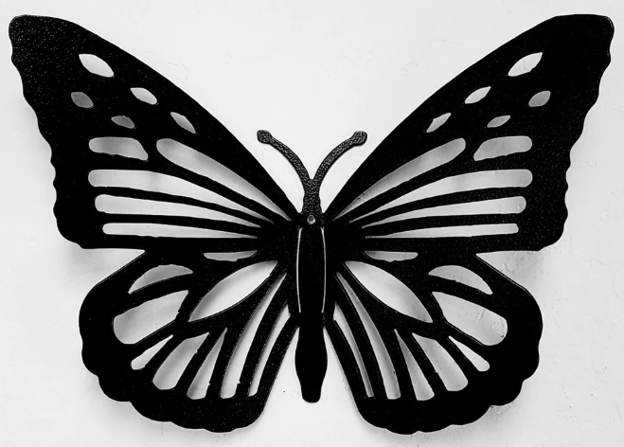




Slide 3





Slide 4


T.N.T.

Slide 5




T.N.T. (The New Team)
Ashlyn Bertsch
Willow Carlton
Mason Gargiulo
Rosalie Higgs
Mya Hill
Eisley Soucie
Nathan VanFarowe

